Slide 1




Slide 2
Presenter’s name: Zahid Asghar
Paper title: Unlocking the Power of Data: Enhancing Public Policy through Advanced Data Infrastructure and Language Model Analysis
Designation: Professor
Affiliation: Quaid-i-Azam University , Islamabad
Email: zasghar@qau.edu.pk

Slide 3
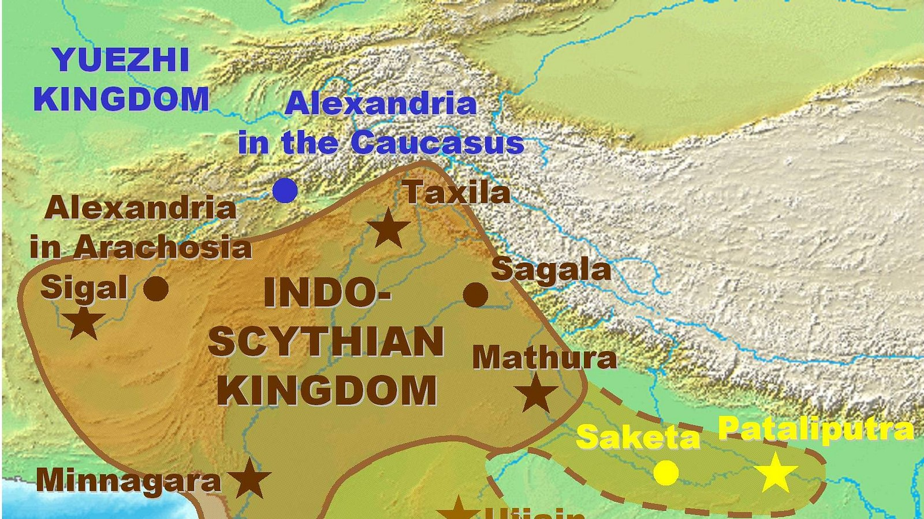






Introdution
Advanced Technology : Driving Force
The Era of Digital Abundance
“Data is the fuel of progress”
Pakistan’s Position : 117/174 AI Readiness

Slide 4
Introduction
The urgency of integrating data analytics in policy formulation and execution.
The importance of both structured and unstructured data.
The necessity of investing in data infrastructure and capacity building.
The role of data analytics in augmenting, not replacing, expert opinions.
Encouraging a cultural shift towards valuing data as a critical tool for effective governance.

Slide 5
Methodology
Data Collection and Preprocessing
Data Source:
Monetary Policy Statements (MPS) from the State Bank of Pakistan (2005–2024).
A total of 86 documents collected in PDF format.
Preprocessing Steps:
Conversion to text format.
Cleaning and tokenization: removed stop words, converted to lowercase, stemmed words.
Document-Term Matrix (DTM) created for analysis.

Slide 6
Methodology
Text Analysis Techniques
Sentiment Analysis:
Used Loughran and McDonald financial sentiment dictionary.
Context-aware sentiment scoring for economic terms (e.g., “increase” in inflation context).
Topic Modeling:
Applied Latent Dirichlet Allocation (LDA) to identify key topics.
Topics include monetary policy, inflation, growth, and fiscal balances.

Slide 7
Research Questions/Objectives
Objective 1: Recognize data as a strategic asset in governance.
Objective 2: Explore the effective utilization of public policy data.
Objective 3: Harness NLP and LLMs to analyze monetary policy statements.
Key Question: How can unstructured data enhance public policy formulation and implementation?

Slide 8
Main Findings
Finding 1: Text mining can transform unstructured data into strategic insights, improving decision-making.
Finding 2: Sentiment analysis of SBP’s monetary policy statements revealed a generally neutral tone, avoiding extremes (hawkish or dovish).
Finding 3: Topic modeling identified four critical themes: monetary policy, inflation, growth, and fiscal balances.

Slide 9
Main Findings
Text Mining Potential:
Successfully transformed unstructured monetary policy data into structured insights.
Revealed patterns and themes in SBP's policy communications.
Neutral Policy Tone:
Sentiment analysis showed SBP’s statements maintain a neutral tone, avoiding strong hawkish or dovish biases.
This neutrality reflects balanced policy communication.

Slide 10
Main Findings
Topic Modeling Findings:
Four main topics from monetary policy statements:
Monetary Policy and Growth: Focused on rates, inflation, and growth strategies.
Inflation and Monetary Measures: Highlighting inflation trends and central bank responses.
Economic Growth and Balance of Payments: Discussed trade deficits and sectoral impacts.
Fiscal Policy and Inflation Dynamics: Addressing deficits and fiscal management.
Shifts Over Time:
Observed shifts in policy focus across years (e.g., emphasis on inflation post-2018).

Slide 11
Policy Recommendations (If Any)
1. Enhance Data Infrastructure
Invest in robust and standardized data collection, storage, and processing systems.
Prioritize machine-readable formats for all policy documents to support AI-driven analysis.
2. Institutionalize Text Analysis Tools
Integrate Natural Language Processing (NLP) and sentiment analysis into policymaking processes.
Train public sector staff in text mining and data-driven decision-making.
3. Promote Data Quality and Trust
Establish strict data governance policies emphasizing quality, privacy, and transparency.
Build public trust by securing sensitive information and ensuring responsible data usage.
4. Improve Policy Communication
Simplify technical jargon in monetary policy statements to engage a wider audience.
Adopt user-friendly formats and data visualizations to enhance accessibility and understanding.
5. Leverage AI for Policy Insights
Use AI-driven tools for real-time analysis of economic indicators and trends.
Apply advanced analytics to anticipate economic challenges and design proactive policies.

Slide 12

Thank You

